Slide 1
Apache Hive
Prof Jigna Patel
CSE Department, Institute of Technology
Nirma University

Slide 2


Slide 3
RoadMap
• What is Hive?
• Story of Apache Hive – From Facebook to Apache
• Advantages of Apache Hive
• Apache Hive – NASA Case Study
• Apache Hive Architecture
• Meta store Configuration
• Hive Data Model

Slide 4
The Hadoop ecosystem contains different sub-projects (tools) such as Sqoop, Pig, and Hive that are used to help Hadoop modules.
•Sqoop: It is used to import and export data to and fro between HDFS and RDBMS.
•Pig: It is a procedural language platform used to develop a script for MapReduce operations.
•Hive: It is a platform used to develop SQL type scripts to do MapReduce operations.

Slide 5
What is Hive?
Hive is a data warehouse infrastructure tool to process structured data in Hadoop. It resides on top of Hadoop to summarize Big Data and makes querying and analyzing easy
Initially Hive was developed by Facebook, later the Apache Software Foundation took it up and developed it further as an open source under the name Apache Hive. It is used by different companies. For example, Amazon uses it in Amazon Elastic MapReduce

Slide 6
Hive is not
A relational database
A design for OnLine Transaction Processing(OLTP)
A language for real-time queries and row-level updates

Slide 7
Features of Hive
Here are the features of Hive:
•It stores schema in a database and processed data into HDFS.
•It is designed for OLAP.
•It provides SQL type language for querying called HiveQL or HQL.
•It is familiar, fast, scalable and extensible.

Slide 8
Where to use Apache Hive?
Data Warehousing
Ad-hoc Analysis

Slide 9
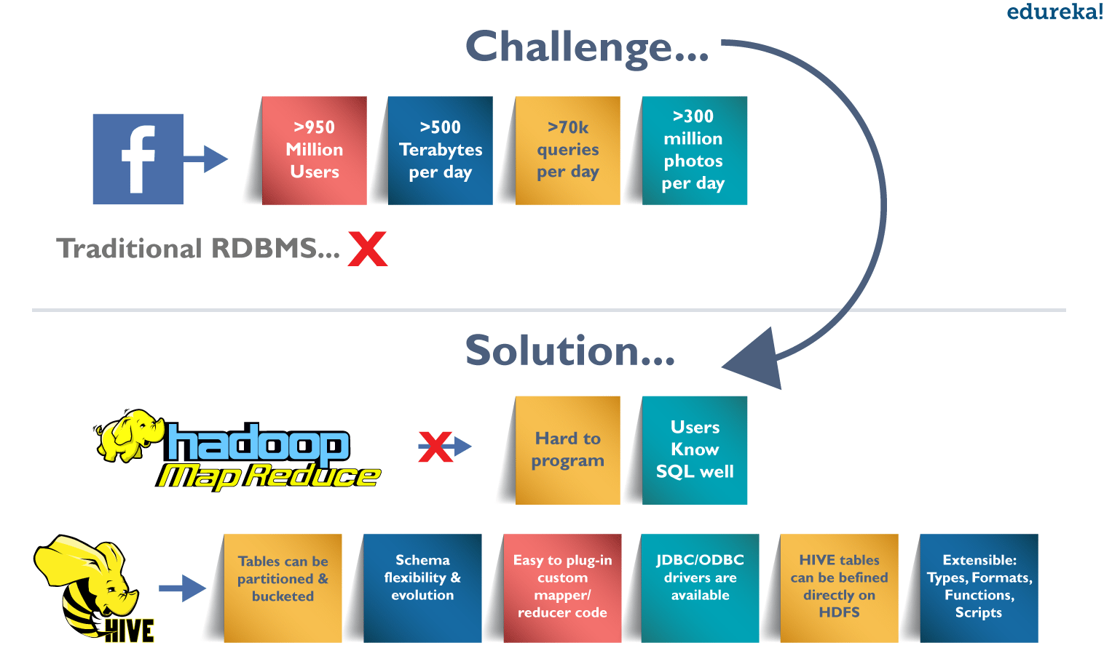
Challenges at Facebook:

Slide 10
NASA Case Study
RCMES (Regional Climate Model Evaluation System)
RCMED (Regional Climate Model Evaluation Database):
RCMET (Regional Climate Model Evaluation Toolkit):
NASA

Slide 11
How Apache Hive can solve the problem?
Since, Apache Hive runs on top of Hadoop, it is scalable and can process data in a distributed and parallel fashion.
It provides Hive Query Language which is similar to SQL and hence easy to learn.

Slide 12
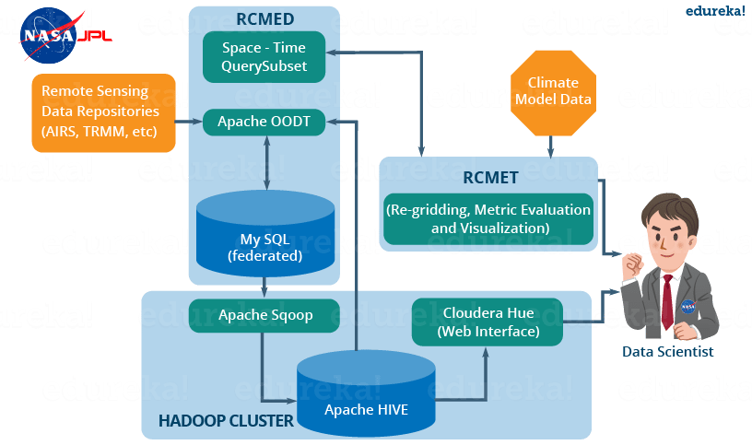
Deployment of Hive:
NASA

Slide 13
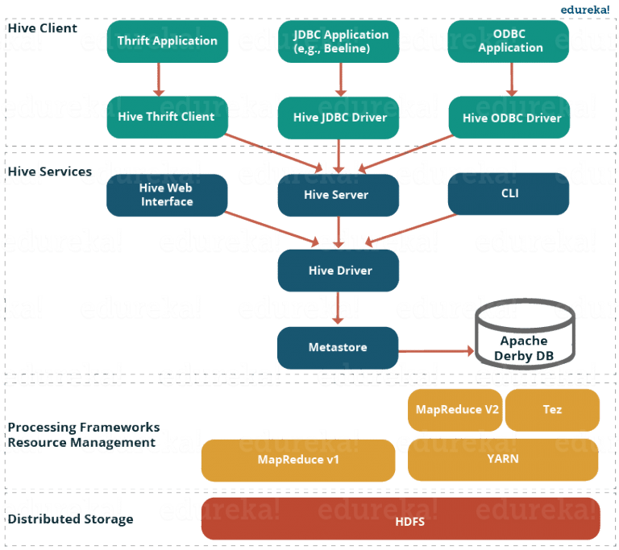
Hive Architecture and its Components

Slide 14
Thank You

Slide 15
References
www.tutorialspoint.com
www.edureka.com

